Slide 1
Market Analysis of S&P 500 Index
Sai Nikhil Kunapareddy and Dileep Shetty
Iteration 03

Slide 2
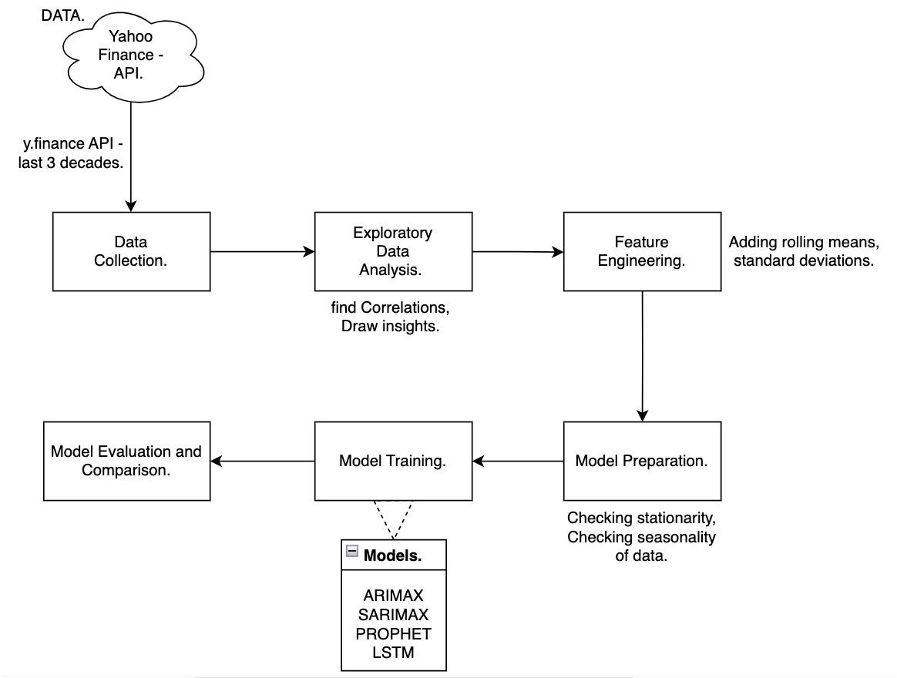
Design Methodology Diagram

Slide 3
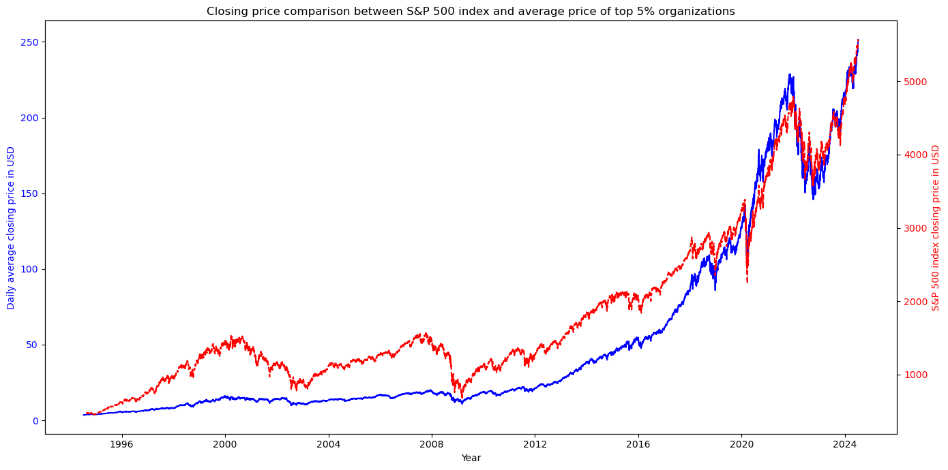
United States Top 5% Vs. S&P 500

Slide 4
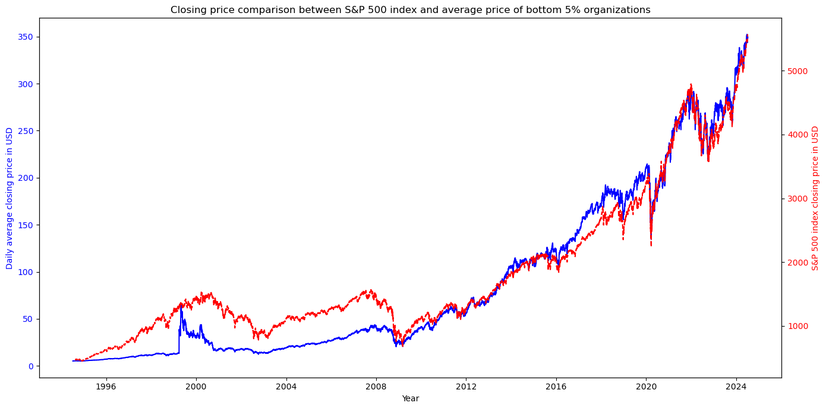
United States Bottom 5% Vs. S&P 500

Slide 5
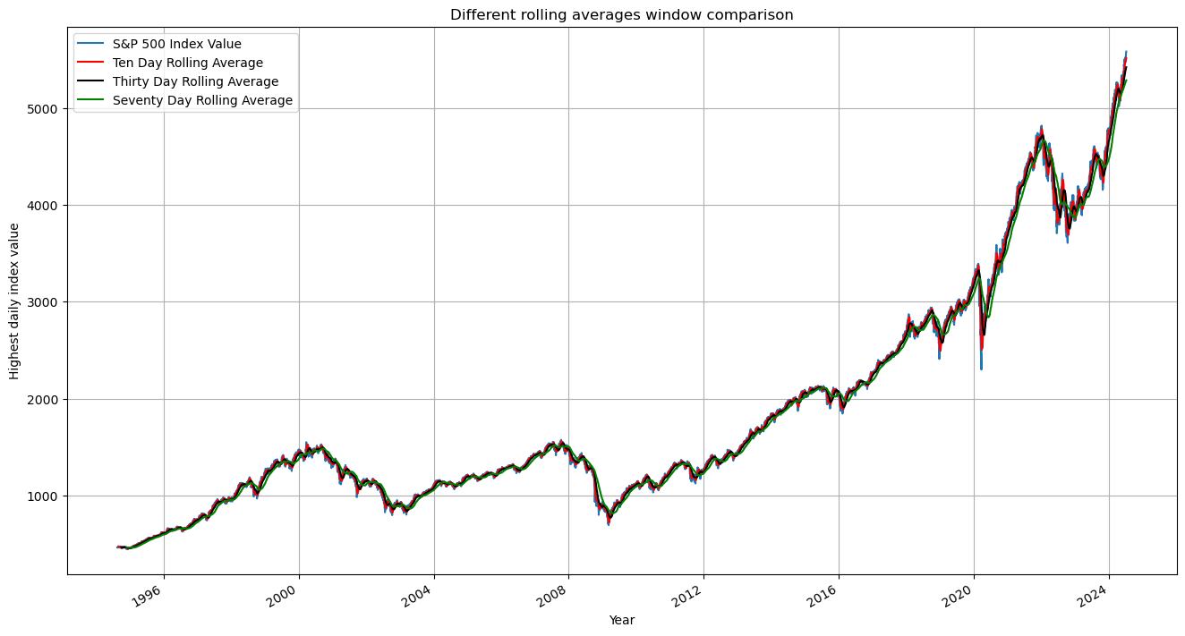
Rolling Average Window Comparison

Slide 6
Data Evaluation
Augmented Dickey-Fuller Test
First Order Differencing
Parameter | Value
ADF Statistic | 2.55
p-value | 0.99
Parameter | Value
ADF Statistic (first differenced) | -14.9
p-value | ~0

Slide 7
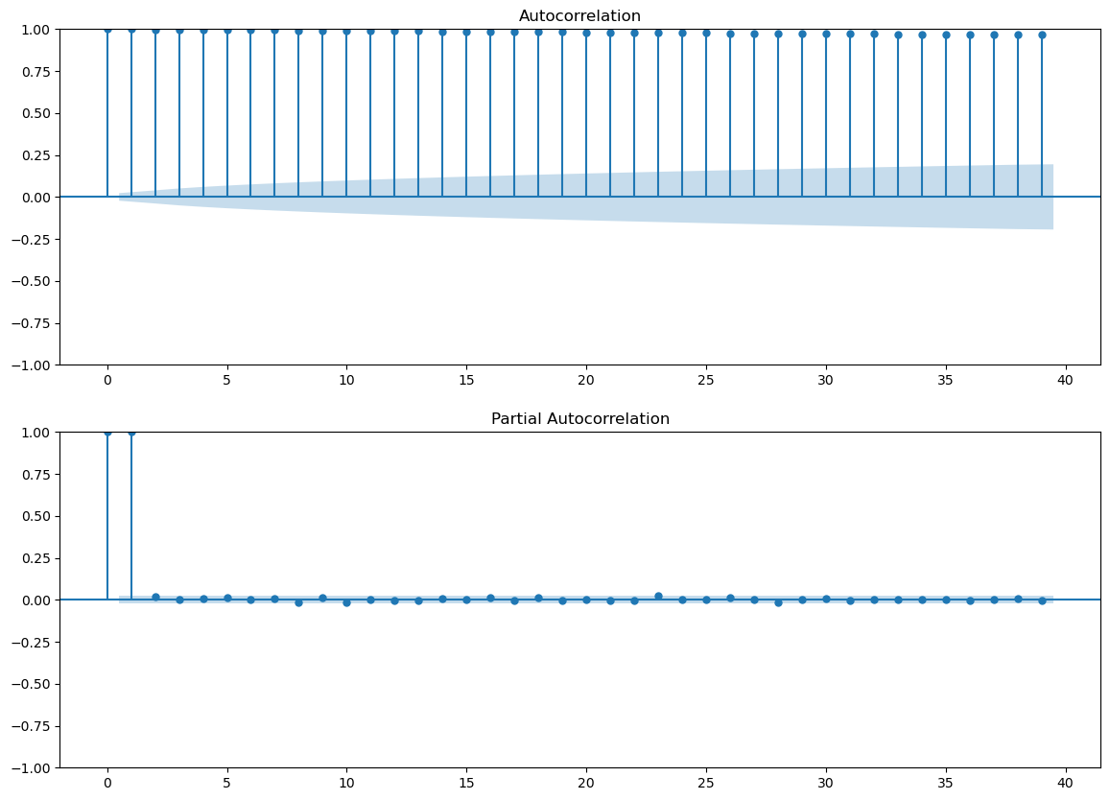
Auto Correction and Partial Autocorrection

Slide 8
Model Training and Evaluation
Autoregressive Integrated Moving Average Model (ARIMA)
Seasonal Autoregressive Integrated Moving Average Exogenous Model (SARIMAX)
Parameter | Value
Mean Absolute Error | 1029
Root Mean Squared Error | 1261
Parameter | Value
Mean Absolute Error | 684
Root Mean Squared Error | 860

Slide 9
Future Steps
Enhance ARIMA and SARIMAX models
Leverage Meta’s Prophet model to predict and compare
Build recurrent neural networks like Long Short-term Memory (LSTM)
Perform a comprehensive comparison study of the models

